Slide 1
Practice Practical
Skull, Ribs, Tibia, Fibula

Slide 2
A
What border is this?

Slide 8
B
A

Slide 9
Left or Right Leg?

Slide 10
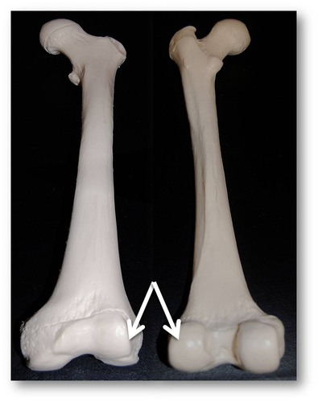

Slide 11
1
2
5
3
6
4
7

